Slide 1



AceNgage
Dec’22 Performance Awards
AceNgage
May’23
Performance Awards

Slide 2

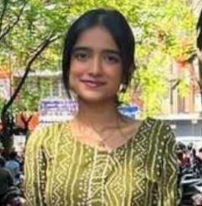


ACE PERFORMER
A quiet and efficient employee with an ability to get work done the Smart Way!
Ananya has been consistent in her performance and delivery of targets. As a senior in the team, she has been most helpful in guiding new joiners and other team members.
Keep Shining Ananya! We are proud to have you in the team!
I
ts exciting to see you achieve your numbers every month ! Keep Rocking !
ANANYA MOJUMDAR
Digital Certificate and
Gift voucher

Slide 3
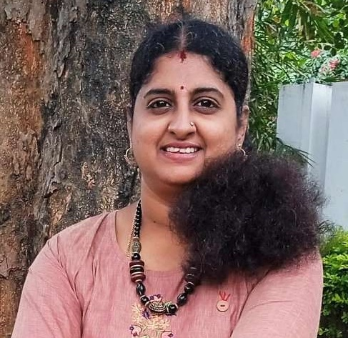
QUALITY PERFORMER
Swati is the most resolute counsellor you will ever come across. Thank you for being someone we can always count on.
The ease with which she overachieves her KRA’s every single month is something the team should replicate!
Not just monthly numbers but Swathi is always ready and willing to assist the larger team whenever required.
Genuinely appreciate everything you do Swathi!
SWATHI M G
Digital Certificate and
Gift voucher

Slide 4
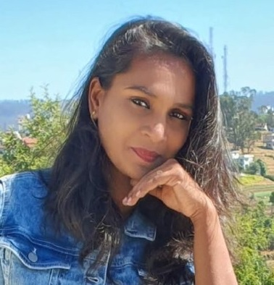
QUALITY PERFORMER
Her dedication and hardwork is hugely appreciated. Her confidence while explaining client specifications with new joiners is also commendable. We love your ability to undertake every task with utmost sincerity.
Lakshmi is prompt in her work and is always available to support her SME. She is an excellent collaborator and delivers tangible results every month!
AceNgage is truly proud to have you as a part of our CE Team. Keep Shining!
LAKSHMI THANUJA
Digital Certificate and
Gift voucher

Slide 5
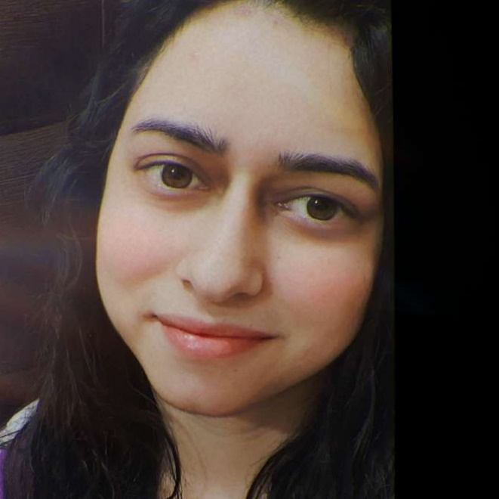
QUALITY PERFORMER
She joined our team in May and proved to be an asset to our team. She was very receptive to feedback and right from first month was on top of her KRA’s.
Navneet loves painting and is a very cheerful and pleasant person. Thank you for being such a team player.
You are always responsible and strive to complete your work well and on time.
It is very appreciated.
NAVNEET KOUR
Digital Certificate and
Gift voucher

Slide 6
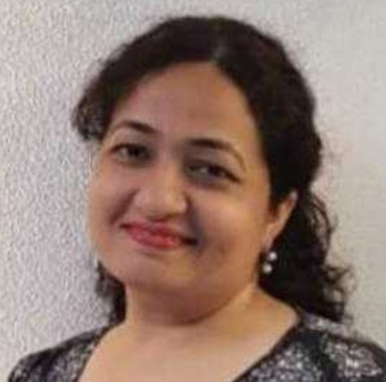
MOST IMPROVED PERFORMER
Seema has come a long way in her performance in the Exit Team!
As a counsellor who has worked on both major processes, she has had an interesting journey in AceNgage.
We are happy and proud of the way you have worked on the feedback shared at every instance and improved your quality and performance.
Keep it up!
Seema Gupta
Digital Certificate and
Gift voucher

Slide 7
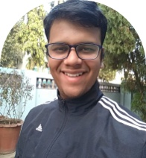
MOST IMPROVED PERFORMER
Ever smiling, ever helpful and always a contributing member of the team - Mayank has brought his own inimitable style of working to the team!
A willingness to learn and “never give up” attitude even when the going gets tough has earned him a special place in the team!
Absolutely delighted to see his quality scores finally touch the benchmark.
His hardwork and dedication is deeply appreciated.
MAYANK MEHTA
Digital Certificate and
Gift voucher

Slide 8
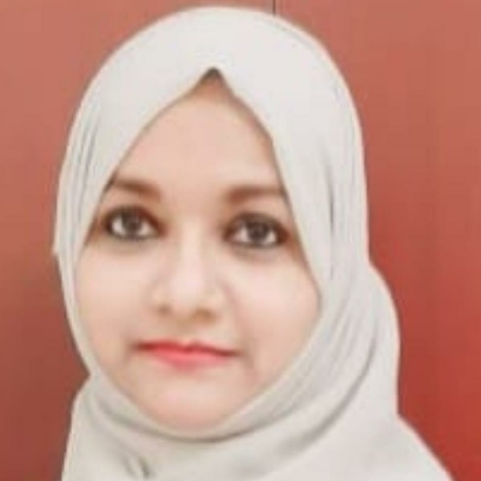
PAT ON THE BACK
People make the difference. And one of those people is you.
Thank you for making a difference in our Team. Your excellence and brilliance have always made for a stunning performance at work.
Thanks for bringing so much reliability to the team!
SYEDA ASHRAF
Digital Certificate and
Gift voucher

Slide 9
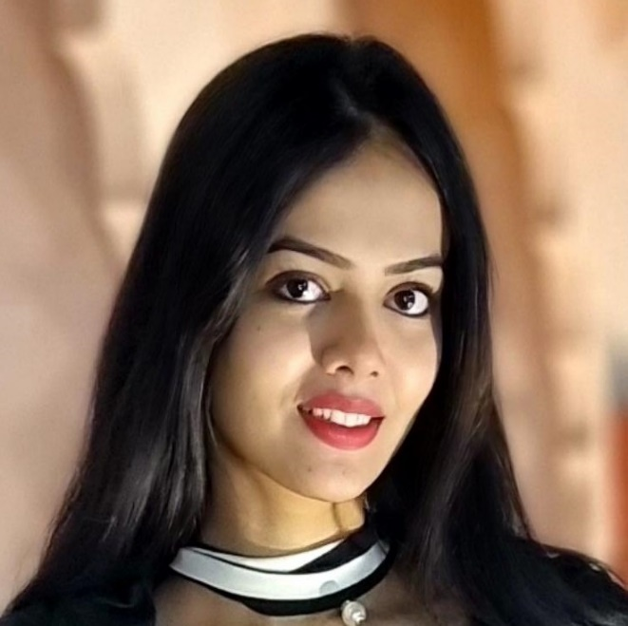
PAT ON THE BACK
Full of energy and passionate about her work,
Muskan has always overachieved her targets and consistently worked on improving each and every day.
She puts a lot of arduous work in everything she does and is always ready to take up challenges!
She has been a great asset to the exit team and in a span of few months, she has proved that efforts and hard work are the key to success!
MUSKAN SHRIVASTAVA
Digital Certificate and
Gift voucher

Slide 10
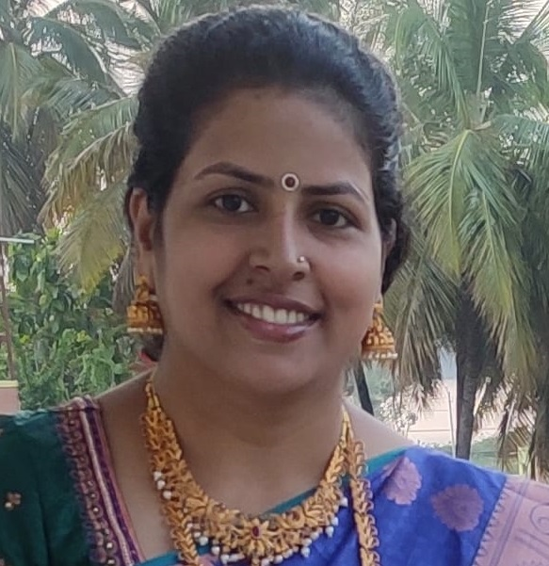
PAT ON THE BACK
You have consistently demonstrated your commitment to excellence, and we have no doubt that your future endeavors will continue to be marked by remarkable achievements.
Your single-minded approach to closing client lists with the required contact rate is truly commendable!
Thank you for your hard work, and dedication, and for being an invaluable asset to our team.
SUDHA K
Digital Certificate and
Gift voucher

Slide 11
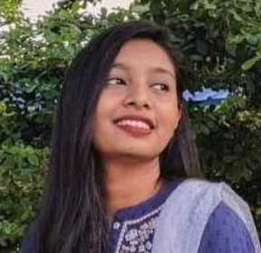
PAT ON THE BACK
Despite being an OJT counselor, Eva has demonstrated remarkable dedication to comprehending and internalizing the process.
Her powerful sense of commitment and creativity distinguishes her and allows her to excel.
Eva consistently displays her value by attentively listening to feedback and effectively implementing it.
Congratulations, Eva! You are an asset to the team.
PRIS EVANGELIN
Digital Certificate and
Gift voucher

Slide 12
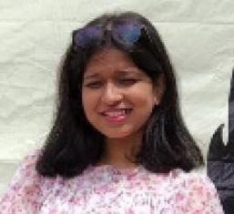
LEADERSHIP CHOICE
She deals with one of the toughest assignments in AceNgage now – Ngage360 tool migration!
It calls for a lot of commitment, patience and dedication and she has displayed all of these appropriately by giving it her best! She handles the continuous coordination, discussion, negotiations, and expectation management of various stakeholders with a calm and composed approach.
Behind her soft-spoken nature is a tough lady with the ability to multitask! Excellent work so far Dhamini!
Keep it up and here is wishing you the best. Super Well Done indeed!!!
DHAMINI NIJGAL
Digital Certificate and
Gift voucher

Slide 13
WINNERS LIST
ANANYA MOJUMDAR
SWATHI M G
LAKSHMI THANUJA
NAVNEET KOUR
SEEMA GUPTA
MAYANK MEHTA
SYEDA ASHRAF
MUSKAN SHRIVASTAVA
SUDHA K
PRIS EVANGELIN
DHAMINI NIJGAL

Slide 14
Well Done to the winners… – …Good Luck for June’23

